Slide 1
SQL Server Projects & SSDT
SQL Server Data Tools (SSDT) SQL Projects offer excellent functionality to relieve developers of the mundane, manual tasks involved with maintaining databases.
October 4, 2016

Slide 2
Agenda
What is SSDT ?
Design & Code view in a single screen
Ability to add Constraints, Indexes, Foreign Keys and Triggers without changing the screen
‘Declarative – Model Based Development’
Connected Development
Disconnected Development
Schema Comparison
Saving snapshots of the Database
Ability to find any errors or reference issues in design time
Exercise

Slide 3
What is SSDT?

Slide 4
What is SSDT?
SQL Server Data Tools (SSDT) is a toolset which provides an integrated environment for database developers to carry out all their database design work for any SQL Server platform (both on and off premise) within Visual Studio.
Database developers can use the SQL Server Object Explorer in VS to easily create or edit database objects and data, or execute queries.

Slide 5
Design & Code view in a single screen

Slide 6
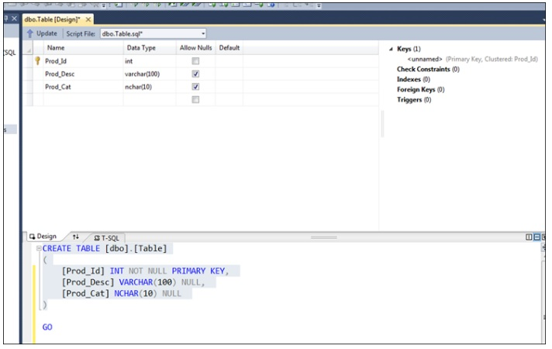
Design & Code view in a single screen
Ability to see the design view and the code view in a single screen is a wonderful thing. You do not have to move across screens. And the changes you do to the design view will be affected to the code immediately and vice versa.

Slide 7
Ability to add Constraints, Indexes, Foreign Keys and Triggers without changing the screen

Slide 8
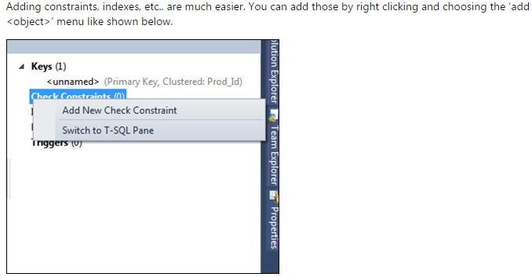
Ability to add Constraints, Indexes, Foreign Keys and Triggers without changing the screen

Slide 9
‘Declarative – Model Based Development’

Slide 10
‘Declarative – Model Based Development’
What this means is that there is always an in-memory representation of what a database looks like—an SSDT database model— and all the SSDT tools (designers, validations, IntelliSense, schema compare, and so on) operate on that model.
This model can be populated by a live connected database (on-premise or SQL Azure), an offline database project under source control, or a point-in-time snapshot taken of an offline database project (you will work with snapshots in the upcoming exercises). But to reiterate, the tools are agnostic to the model’s backing; they work exclusively against the model itself. Thus, you enjoy a rich, consistent experience in any scenario—regardless of whether you’re working with on-premise or cloud databases, offline projects, or versioned snapshots.

Slide 11
Connected Development

Slide 12
Connected Development
You can open query windows to compose and execute T-SQL statements directly against a connected database, with the assistance of a debugger if desired, just as you can in SSMS

Slide 13
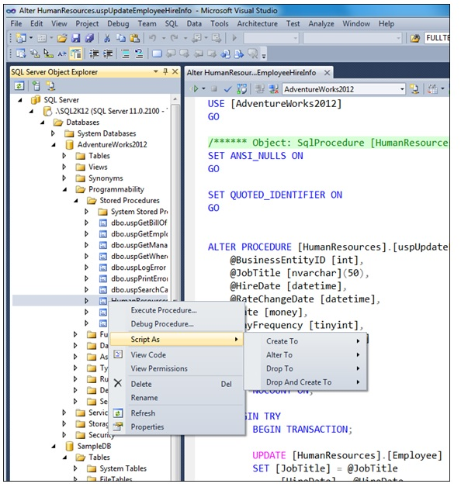
Connected Development

Slide 14
Disconnected Development

Slide 15
Disconnected Development
The new SQL Server Object Explorer lets you connect to and interact with any database right from inside Visual Studio. But SSDT offers a great deal more than a mere replacement for the connected SSMS experience. It also delivers a rich offline experience with the new SQL Server Database Project type and local database runtime (LocalDB).
Actually this is one great feature it has. Because due to many reasons, most of the time we are requested to work offline, or to do our development locally and later on merged. So this feature allows us to maintain a local database and do all the development using that. And later on merged/published to other database. And by doing a schema comparison, it’s possible to find out the changes we have done.

Slide 16
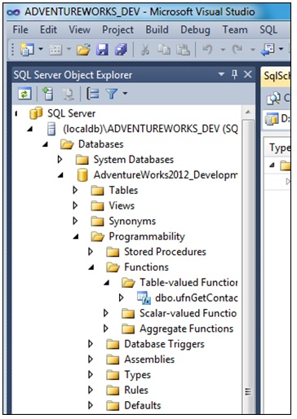
Disconnected Development

Slide 17
Schema Comparison

Slide 18
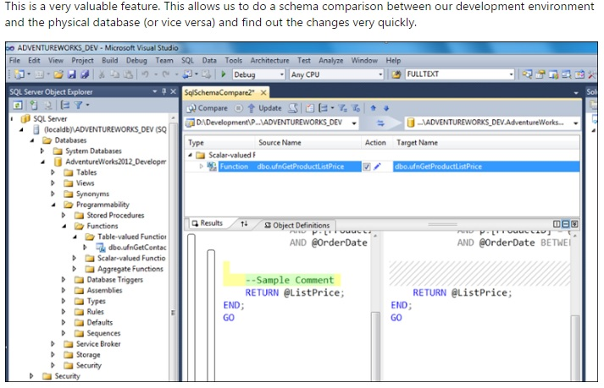
Schema Comparison

Slide 19
Saving snapshots of the Database

Slide 20
Saving snapshots of the Database
Sometimes it’s required to keep snapshots of your database at different stages of the development. And the best thing is, it even allows you to compare between two database snapshots. So it’s easy to see the changes you have done compared to the previous stages.

Slide 21
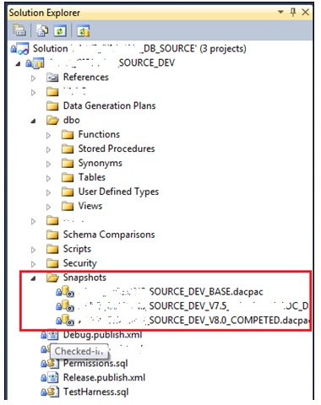
Saving snapshots of the Database

Slide 22
Ability to find any errors or reference
issues in design time

Slide 23
Ability to find any errors or reference issues in design time
When SSDT is used it’s easy to identify any syntax issue or any reference issue before deploying it to the database. E.g. assume we have one view which is referring to few columns of a table. Usually if someone change or remove any columns from the table which this view is referring, there is no way of identify that, till the view is used in our application. But when SSDT is used, it will show you these issues, when building the project. So these can be eliminated before we apply these to the deployment server.

Slide 24
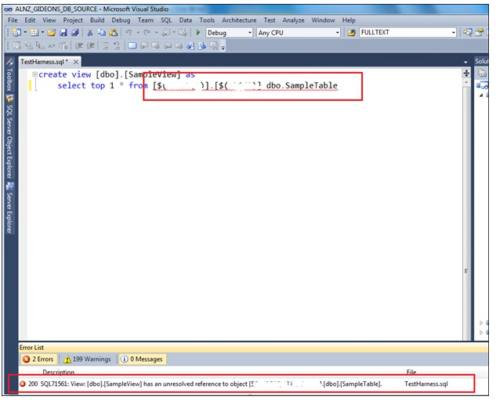
Ability to find any errors or reference issues in design time

Slide 25

Thank You!
Salil Belapurkar
Technical Lead
Mobile: +919850042013
Desk: 6398
Salil.belapurkar@xoriant.com
www.xoriant.com
India
Mumbai
4th Floor, Nomura
Powai , Mumbai 400 076
Pune
5th Floor, Amar Paradigm
Baner, Pune 411 045
Kolkata
2B, 12th Floor, Tower ‘C’
Rajarhat, Kolkata 700 156
US – Corporate Headquarters
1248 Reamwood Avenue,
Sunnyvale, CA 94089
Phone: (408) 743 4400
343 Thornall St 720
Edison, NJ 08837
Phone: (732) 395 6900
UK
20 Broadwick Street
Soho, London
W1F 8HT, UK
89 Worship Street
Shoreditch,
London EC2A 2BF, UK
Phone: (44) 2079 938 955
Bangalore
4th Floor, Kabra Excelsior,
80 Feet Main Road, Koramangala 1st Block,
Bengaluru (Bangalore) 560034
Gurgaon
A/373rd Floor, Sigma Center
Gurgaon, Haryana 122 011s

